Slide 1
BACHKHOA-APTECH
Training center of international programmers
BACHKHOA - APTECH
PROJECT
Semester III
Team 1 – C1208H
Project :Online Order For Didgital Photo Printing

Slide 2
BACHKHOA-APTECH
Training center of international programmers
BACHKHOA - APTECH
Website designed by the members:
+ Nguyen Khac Hieu(L)
+ Tran Trong Nam
+ Nguyen Manh Quan
+ Nguyen The Huy
+ Pham Van Tri
Supervisor:
Mr.Nguyen Song Huong

Slide 3
Content
Introduction about Project
Functionalities of website
DB - Diagram
Diagram website

Slide 4
Introduction about project
System website name: Online Order For Didgital Photo Printing is product of Team I – C1208H
System and develop applications on the web
Object is used all the object to printing photo online
Deployment environment: Applications deployed on the web, Server support ASP.net and SQL server
Languages development: ASP.Net, JavaScript, HTML, DHTML, SQL
Tools development: Microsoft visual studio 2010, Adobe Photoshop CS3, My SQL server 2008
Server : Visual Studio 2010

Slide 5

Functionalities of website
Register
Log in
Upload images
Manage personal infomation
(change,update,delete)
Manage cart
Send feedback
Contact to administrators
Log out

Slide 6

Functionalities of website
Has all customer’s functions
Manage order
Manage photos
Manage customer’s infomations
Manage contact

Slide 7
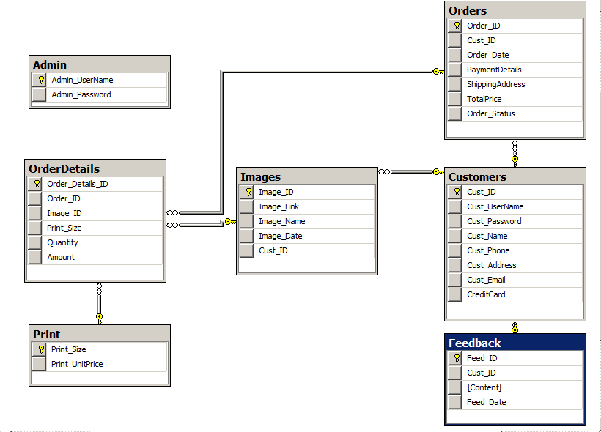
DB Diagram

Slide 8
Diagram website
Home
Choose Photo
Sitemap
Contact
Register
Photo Detail
Manage Info
Send Photo
Login
Customer
View Cart
Feedback
Administrator
Manager Photo
Manager Contact
Manager User

Slide 9


